Slide 1




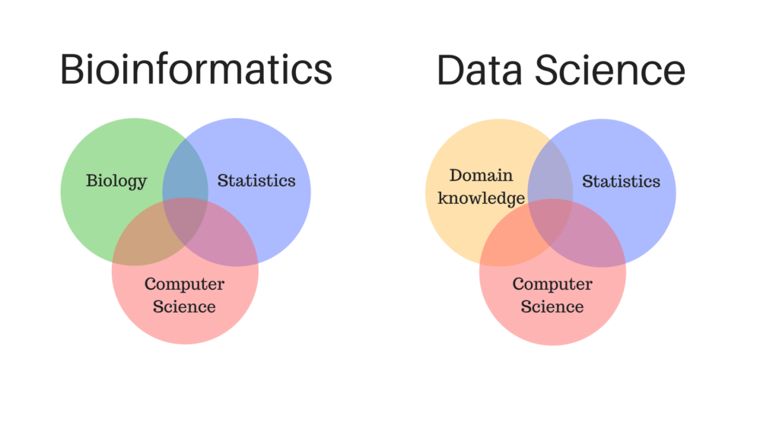
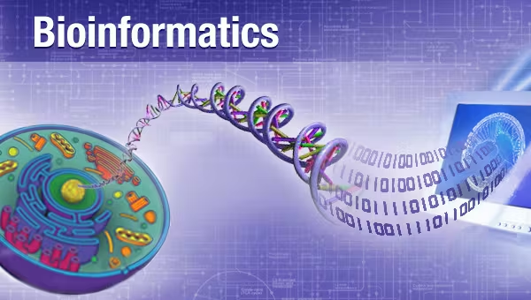
Introduction to Bioinformatics
Study program: Bioprocess Engineering
Elective Module (Wahlpflichtmodul)
9th October to 13th October
Responsible: Prof. Dr. Axel Blokesch, blokesch@fb2.fra-uas.de
by Pablo Riesgo-Ferreiro, TRON gGmbH
pablo.riesgoferreiro@tron-mainz.de
Day 2 - Session 1

Slide 2
Outline of session
Version control with git
Online biological databases
Online genome browsers
Demos
Using Git version control system
Using biological databases

Slide 3
Version control with git

Slide 4

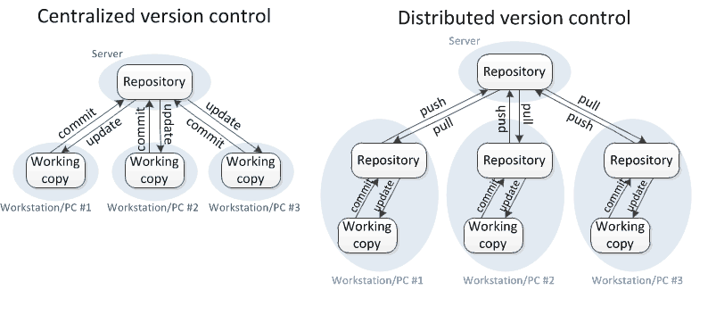
Git and Version Control Systems
Git is a Version Control System (VCS) used to track changes in files
The main particularities are that:
Git is distributed instead of centralized
Git can work without network connection
Git was developed in 2005 by Linus Torvalds
Other VCSs have existed for many years: Subversion (2000), CVS (1990), Perforce (1995). And finally Mercurial (2005) which is very similar to git
Even though VCSs were initially targetting software source code, they can be repurposed for any type of file as far the files are relatively small
Some MBs max, it is still good for images and small PDFs, but it is certainly not fit for FASTQ or BAM files
Git LFS (Large File Storage) is a Git extension to hold larger files

Slide 5

Why should scientists care about Git?
Git can be used as an electronic lab notebook for computational work
By computational work I mean everything you do in a computer, also writing
Objectives
Make **iterative** results reproducible through time
Foster collaboration and shared understanding
Enable auditing
Why should I make my code open?
Making code citable and reusable
Increase citations
Obtain feedback from the community

Slide 6




Services based on Git
Different services to host git repositories exist
GitHub
GitLab
BitBucket
Sourceforge
This makes it possible to migrate between any of these or mirror repositories in different services.
These services offer more functionality beyond Git, but this is out of the scope of this tutorial.

Slide 7
The basic commands
Checkout existing branch
git checkout <branch>
Create new branch and checkout
git checkout -b <branch>
git init
used to initialize a repository
this converts a folder in a git repository
git status
shows if there have been any changes on tracked files
shows if any new file has been added
shows if any tracked file has been deleted
git add <file>
used to start tracking a new file
stage changes in a changed file
git commit -m ‘a memorable commit message’
records staged changes in the repository
git checkout <file>
undo uncommited changes to a file
git push origin master
upload changes to the remote repository
until a push happens, commits are only kept locally
git pull origin master
download changes from the remote repository
making commits locally
communicating with remote repository

Slide 8
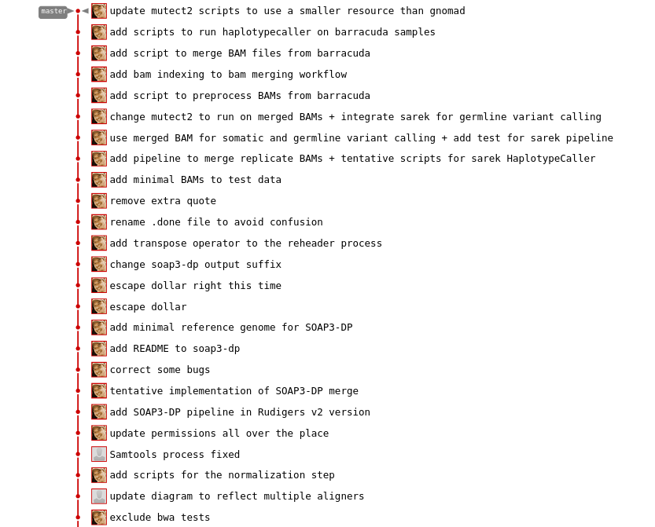
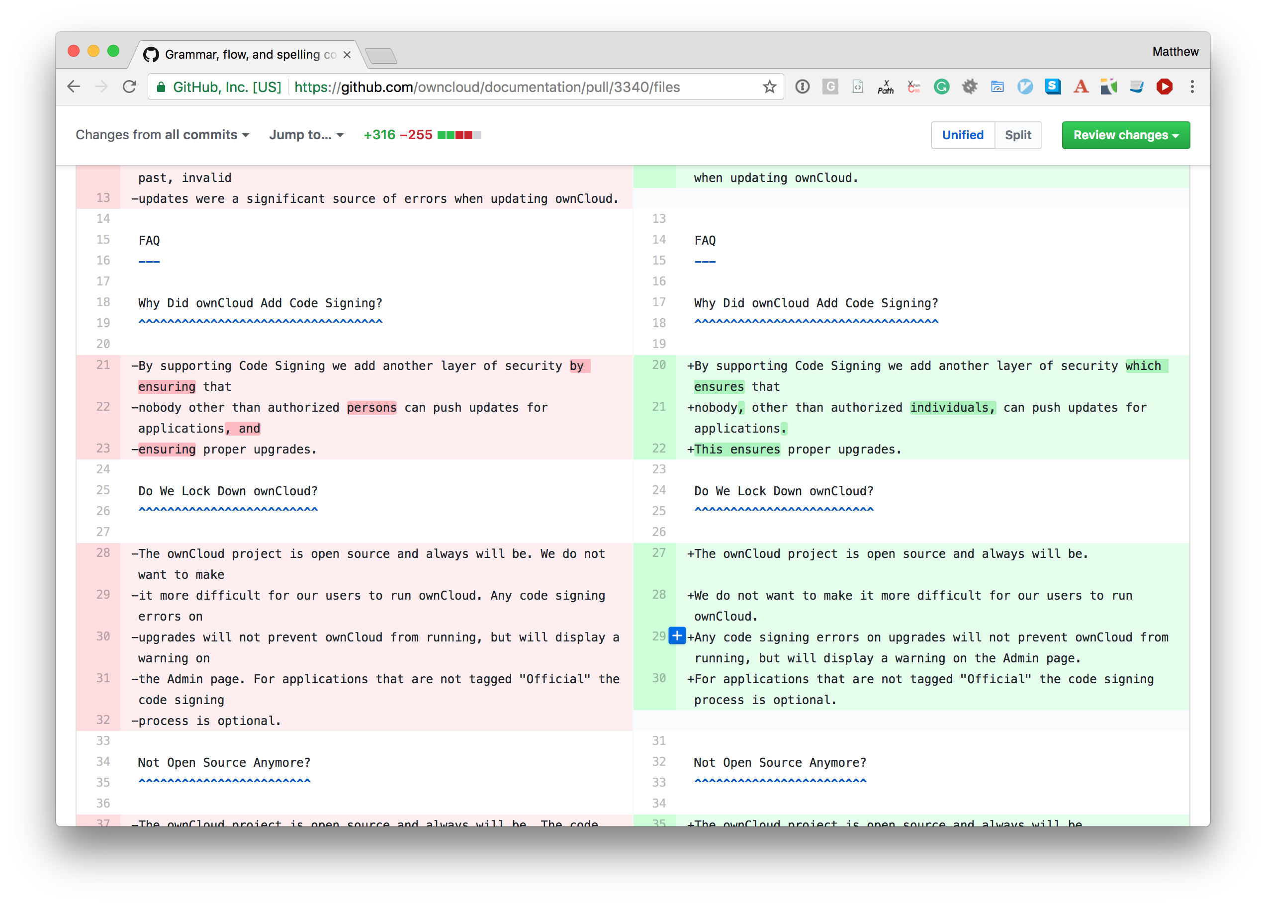
The commit history and diff a file
Every commit is a complete snapshot of the repository and every file at that point in time can be retrieved
Git is still efficient in terms of storage, because it only keep the differences between files

Slide 9
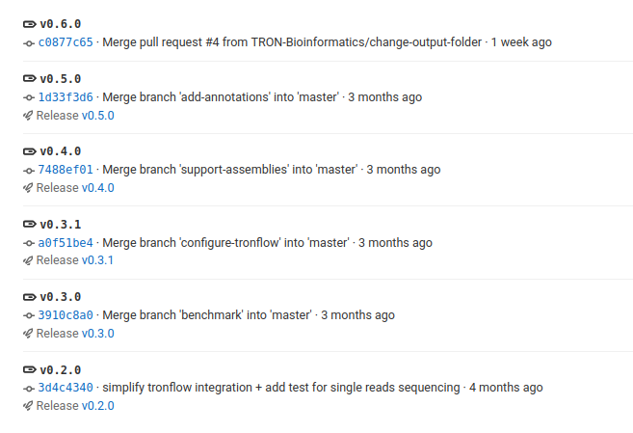
Tags
Tags are just marks on relevant commits to facilitate the navigation of the commit history. They are normally used for releases
tag
commit

Slide 10
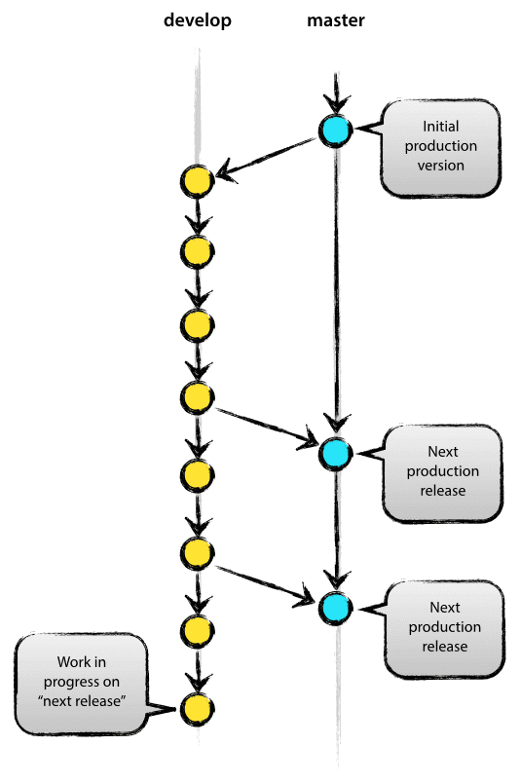
Branching - stable branch and under construction branch
Releases/tags happen on the master branch
No one commits directly to master
Master branch is stable, develop branch may not be stable
NB: the default branch used to be called master and still is in many repositories. But to avoid any reference to slavery the default branch is now called main https://sfconservancy.org/news/2020/jun/23/gitbranchname/
Source: https://nvie.com/posts/a-successful-git-branching-model/

Slide 11
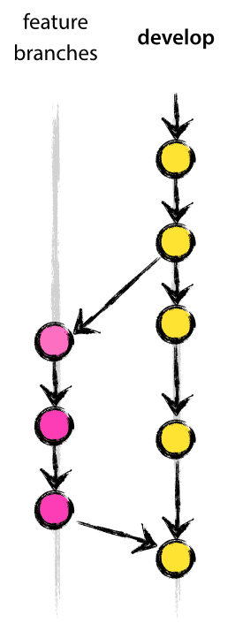



Branching - supporting multiple contributors
Each feature is developed in its isolated feature branch
No one commits directly to develop, but you may commit to a feature branch
Once the feature is stable and tested it is merged into develop
Feature branches can be archived until they are selected for inclusion in a release and subsequently merged into develop
In case of multiple developers there may be conflicts and a feature branch may need to be updated with the latest changes in the develop branch
Rejected due to a conflict
Source: https://nvie.com/posts/a-successful-git-branching-model/
Fix the conflict “manually”

Slide 12

Branching - the whole thing
Releases are made from a release branch
Version increase happens in the release branch
Acceptance tests happen in the release branch
Bug fixes may happen in the release branch
The release branch is merged back into both develop and master
Feature development is not blocked by a release happening
You don‘t need to use all of this! This is all optional
I find particularly useful the separation between develop and main
And only in case that there are two or more contributors the feature branches
Source: https://nvie.com/posts/a-successful-git-branching-model/

Slide 13
How to tell Git to ignore some files
It is many times the case that you have some files locally that you don’t want to commit to the repository (eg: log files, large data files, local configuration, temporary files)
To ignore files, you can use a hidden file named .gitignore at the root of your repository. Every file or folder name listed in that file will be systematically ignored by git (ie: git status will not report anything). Wildcards can be used in the .gitignore file (UNIX wildcards work with * and ** among other things, see https://tldp.org/LDP/GNU-Linux-Tools-Summary/html/x11655.htm if interested)
# example
build
dist
.idea
*.fastq.gz
*.sqlite
*.lock
**/__pycache__

Slide 14
Some more advanced Git, GitLab and GitHub features
Pull requests. Enables multiple people to work simultaneously and provides tool for merging back and resolving conflicts
Continuous Integration (CI) environment. This enables to run tests automatically with every code change
Issues/tasks management system. Provides a rich interface to manage a project
Wiki. Allows you to write documentation for a project
Submodules. Nest other reopsitories in your repository https://git-scm.com/book/en/v2/Git-Tools-Submodules

Slide 15
Demo - using Git
I will follow the script at https://github.com/eficode-academy/git-katas

Slide 16
Online biological databases

Slide 17
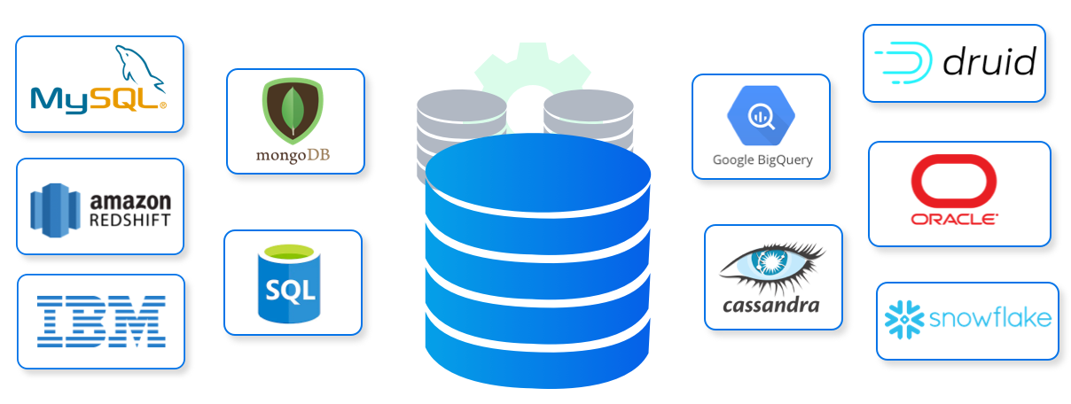
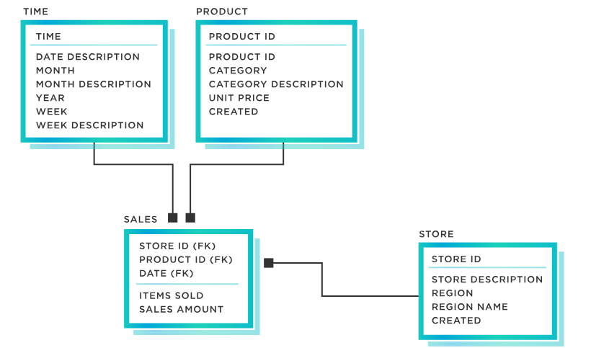
What is a database?
A collection of organized information on a particular subject
It is organized so that queries and reports based on the information are performant
Examples:
Phone book
Student records
Relational databases vs non-relational databases (graph, documents, key-value, columnar, semantic)
Structured Query Language (SQL) is the standard language to query relational databases
Source: https://www.xenonstack.com/hubfs/xenonstack-types-of-databases-tools.png
Source : https://www.tibco.com/reference-center/what-is-a-logical-data-model

Slide 18
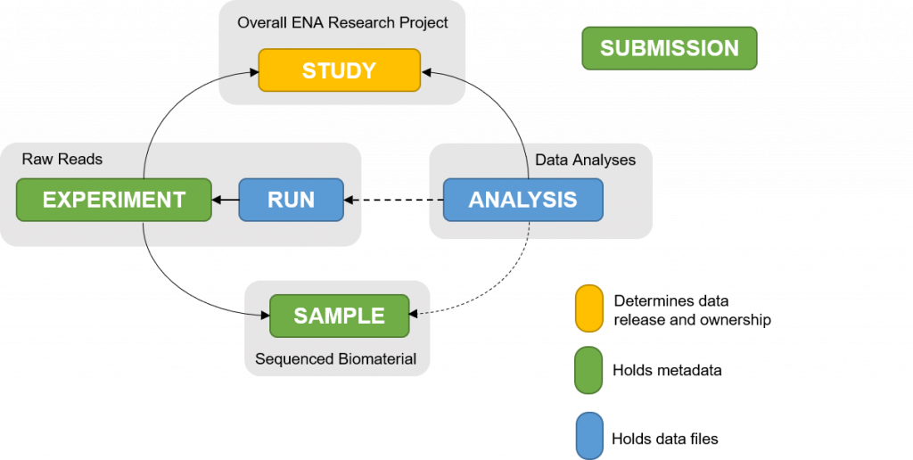
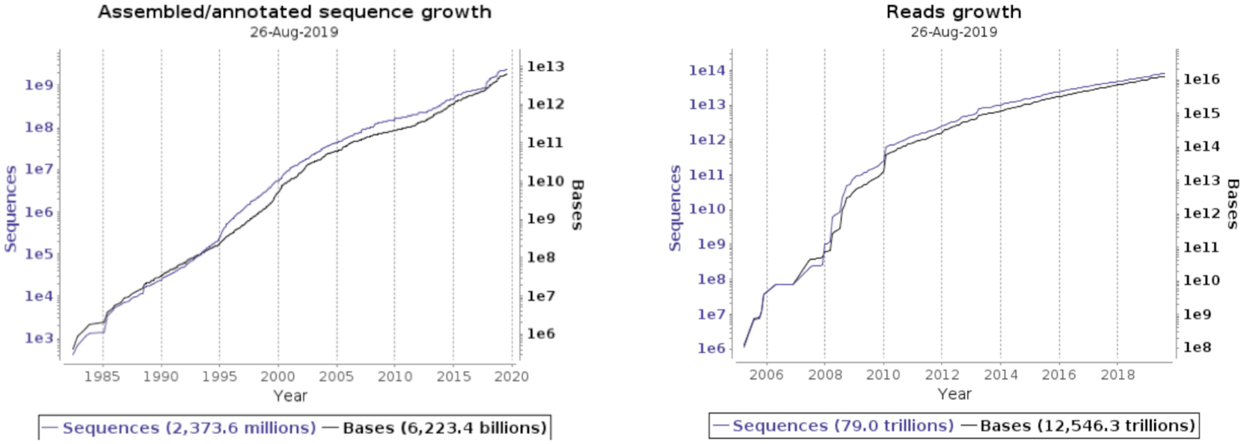
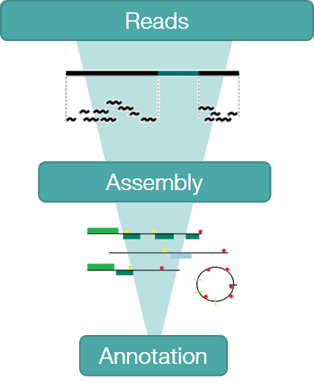
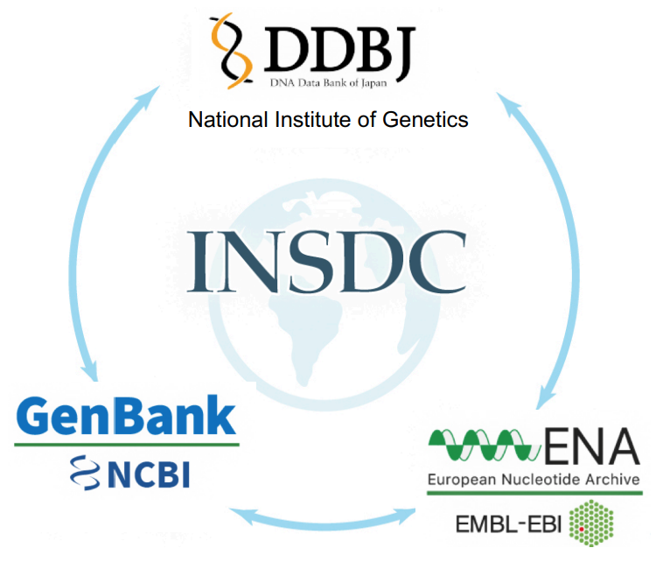
Online biological databases
ENA metadata model
(Amid, 2020)
Databases are synchronized daily
ENA‘s three tiered data architecture
https://www.ebi.ac.uk/training/online/courses/ena-quick-tour/what-is-ena/what-can-i-do-with-resource-name/

Slide 19
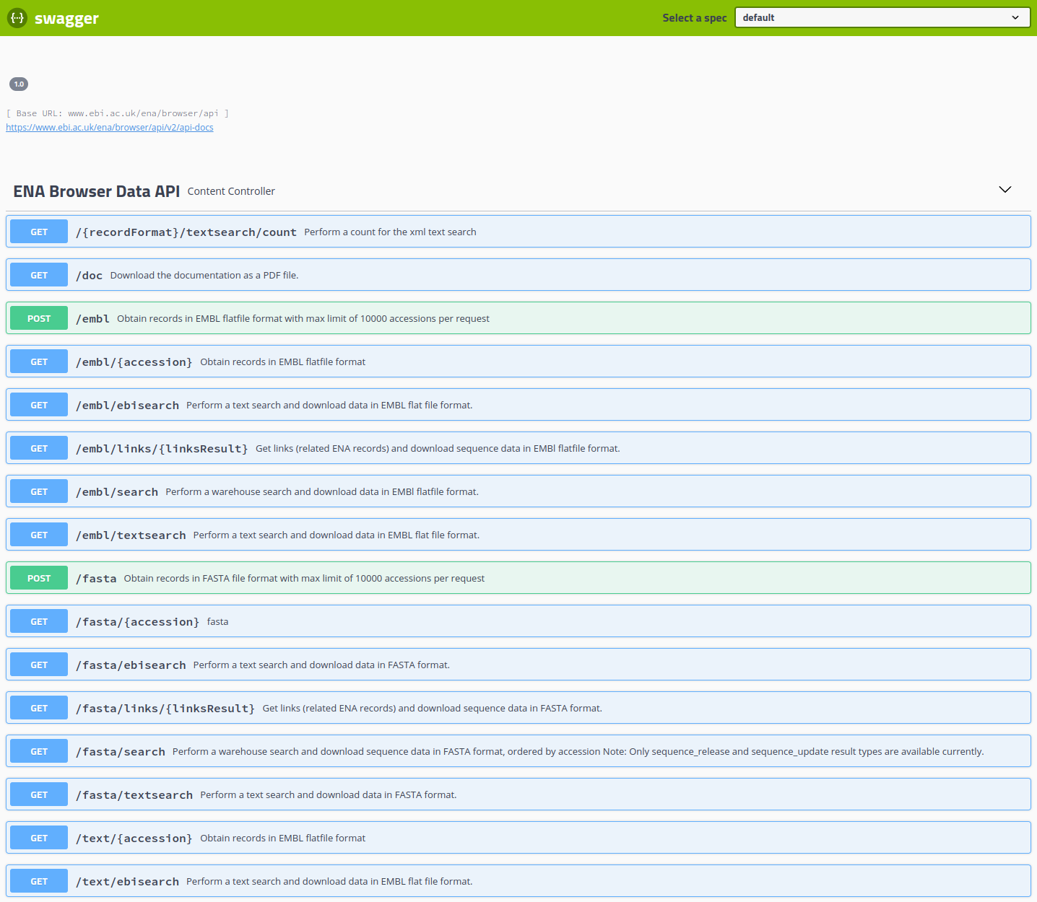
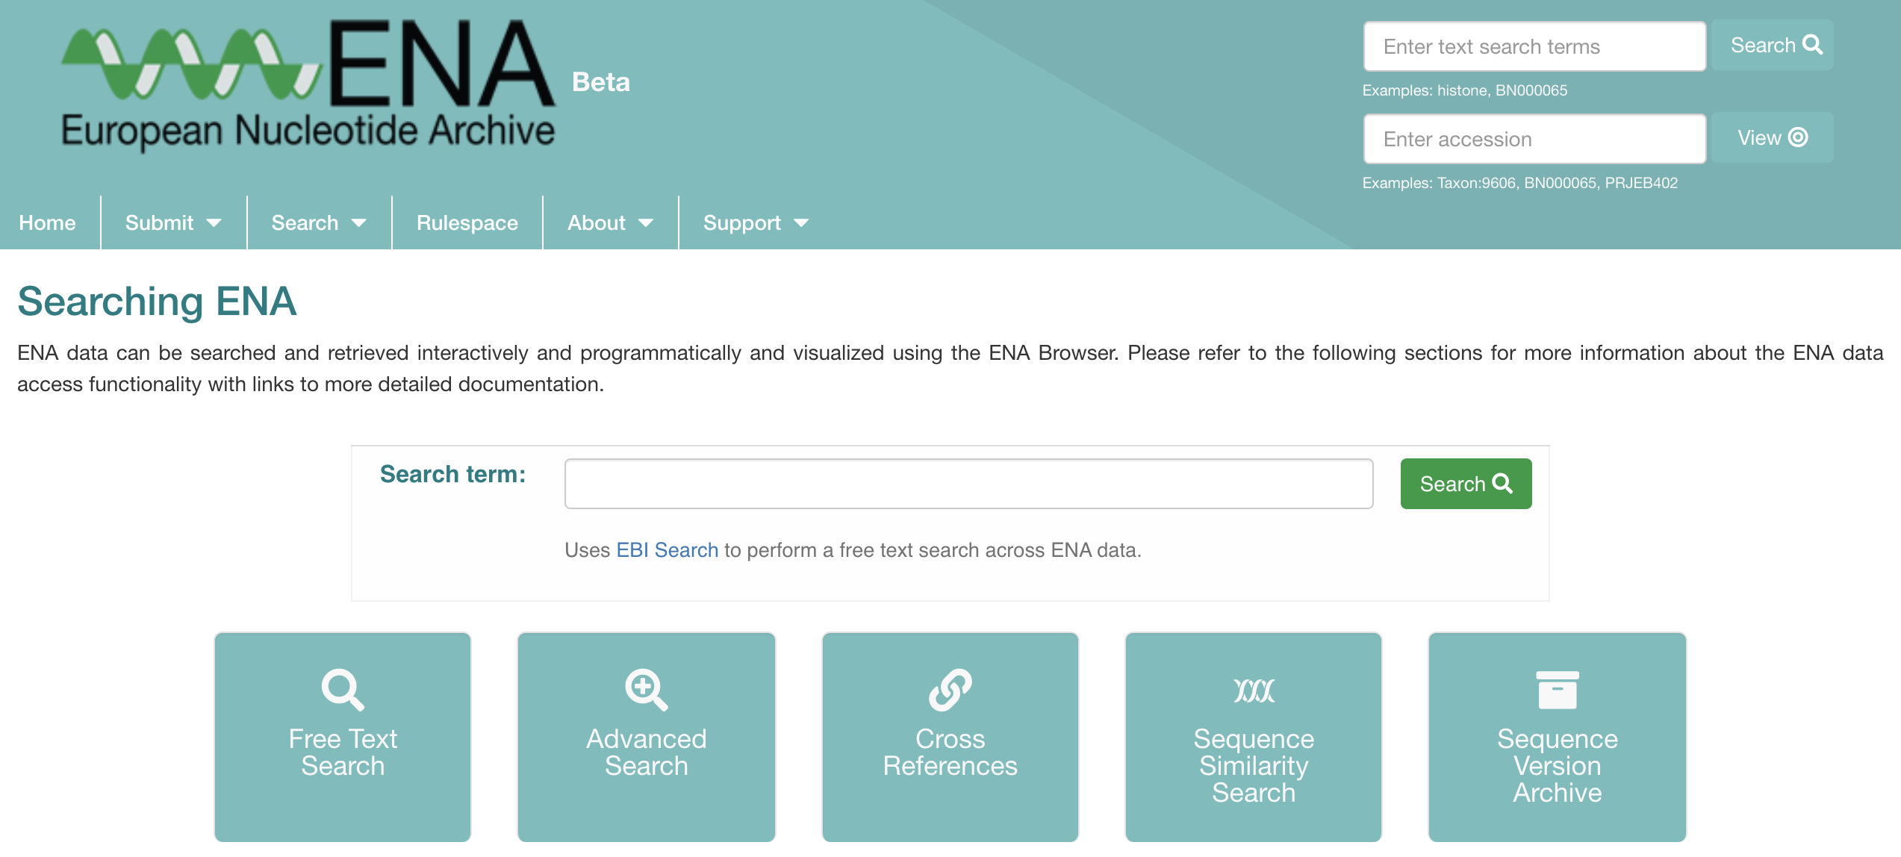
Navigating ENA data and REST APIs
Web browser https://www.ebi.ac.uk/ena/browser/home
API: Application Programming Interface
REST: Representational State Transfer
REST is a software architecture, the one used by the World Wide Web, and it can be summarised in stateless systems
An API is used to programmatically access a resource
REST APIs are the current state of the art to access online databases programmatically
REST API for programmatic access https://www.ebi.ac.uk/ena/portal/api/swagger-ui/index.html https://www.ebi.ac.uk/ena/browser/api/swagger-ui.html
https://ena-docs.readthedocs.io/en/latest/retrieval/programmatic-access.html
Practical use case 1

Slide 20
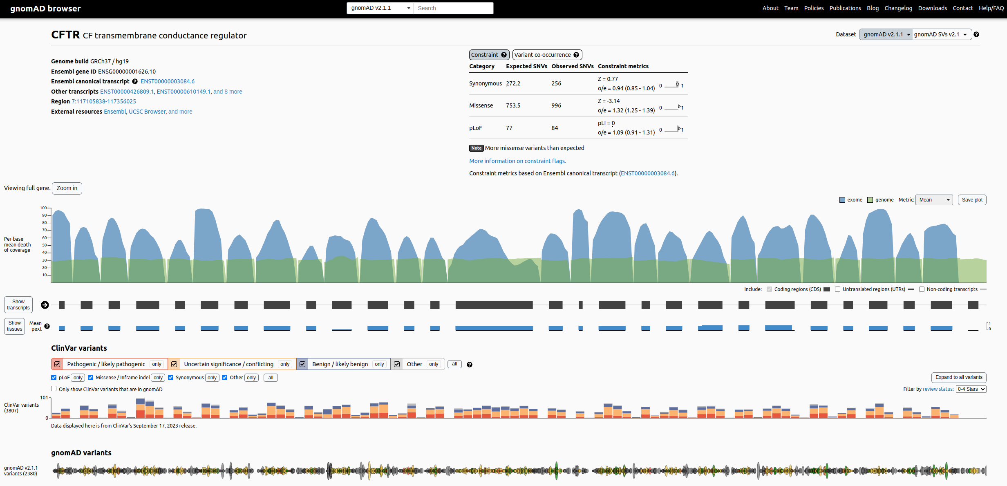
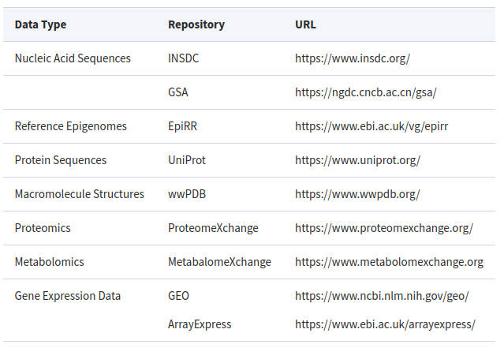
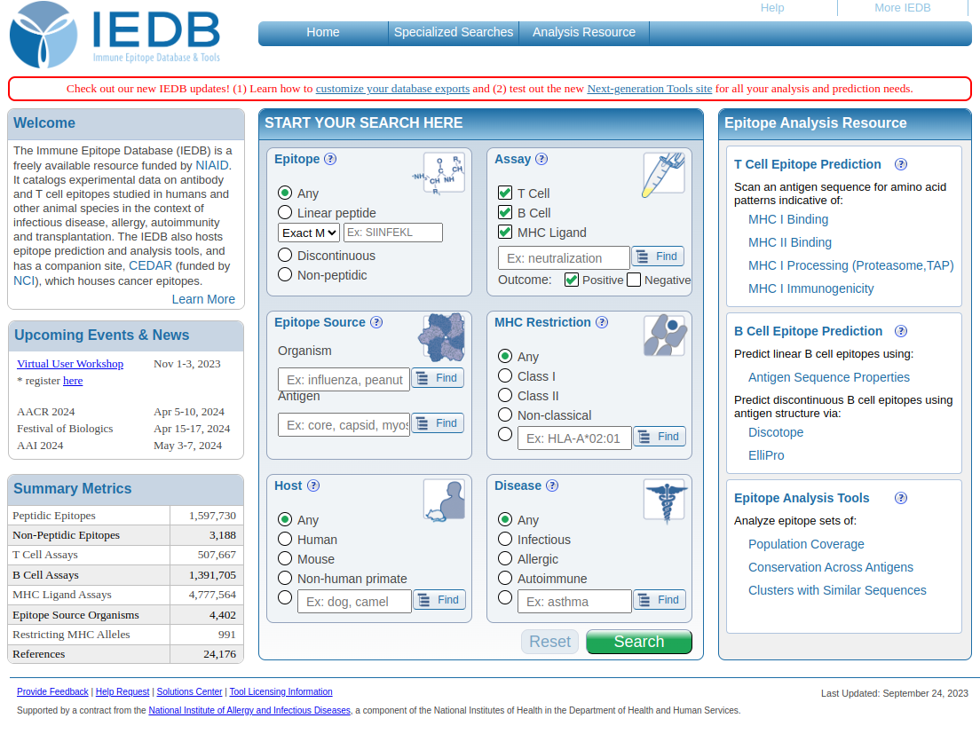
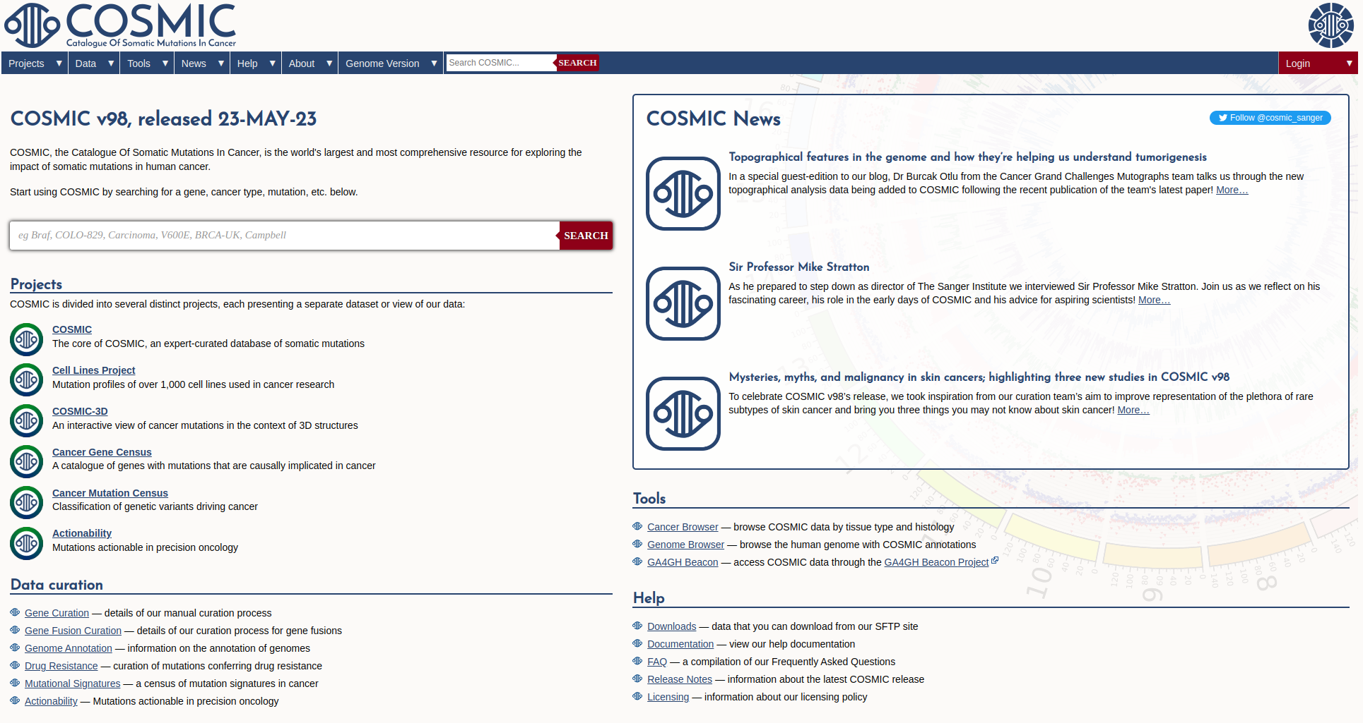
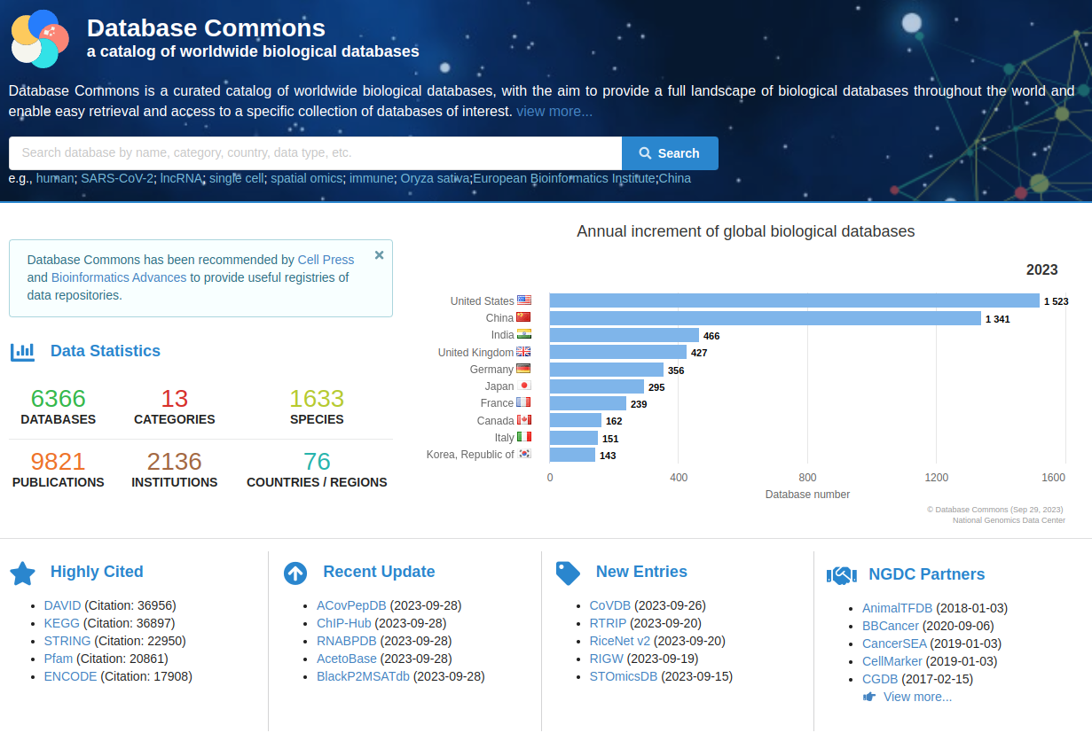
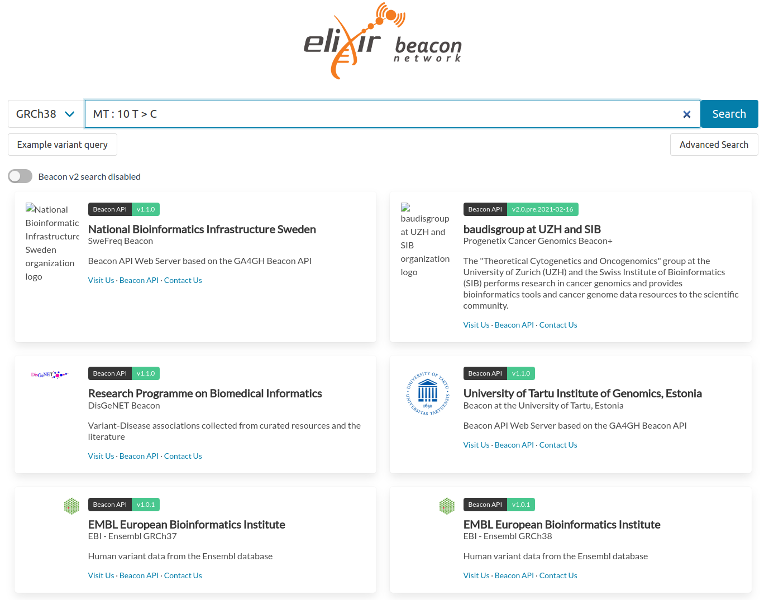
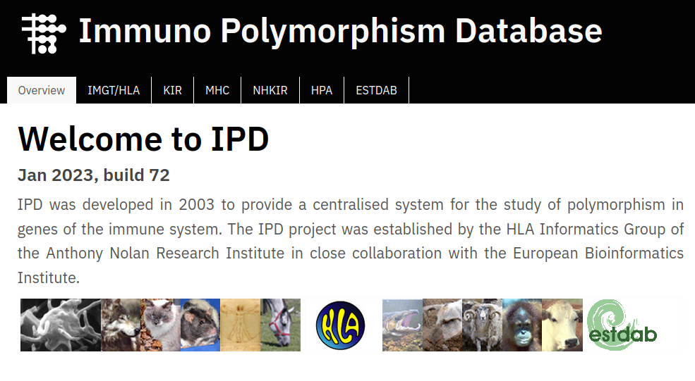
More and more biological databases
https://gnomad.broadinstitute.org/ (Karczewski, 2020)
https://academic.oup.com/bioinformaticsadvances/pages/instructions-to-authors
https://www.iedb.org/ (Vita, 2019)
https://cancer.sanger.ac.uk/cosmic (Tate, 2019)
https://ngdc.cncb.ac.cn/databasecommons/ (Ma, 2022)
https://beacon-network.elixir-europe.org/ (Rueda, 2022)
https://www.ebi.ac.uk/ipd/ (Robinson, 2013)

Slide 21
Demo - using biological databases
An overview of ENA and Ensembl

Slide 22
Genome browsers

Slide 23
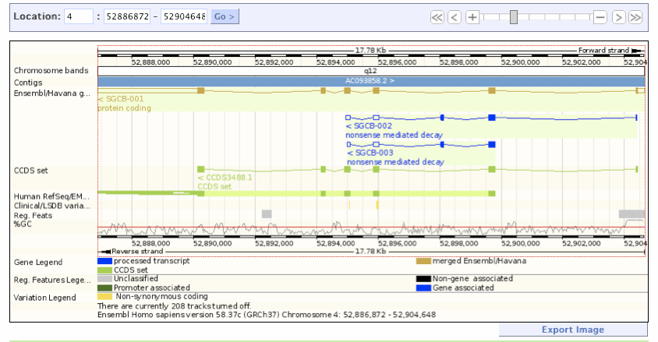
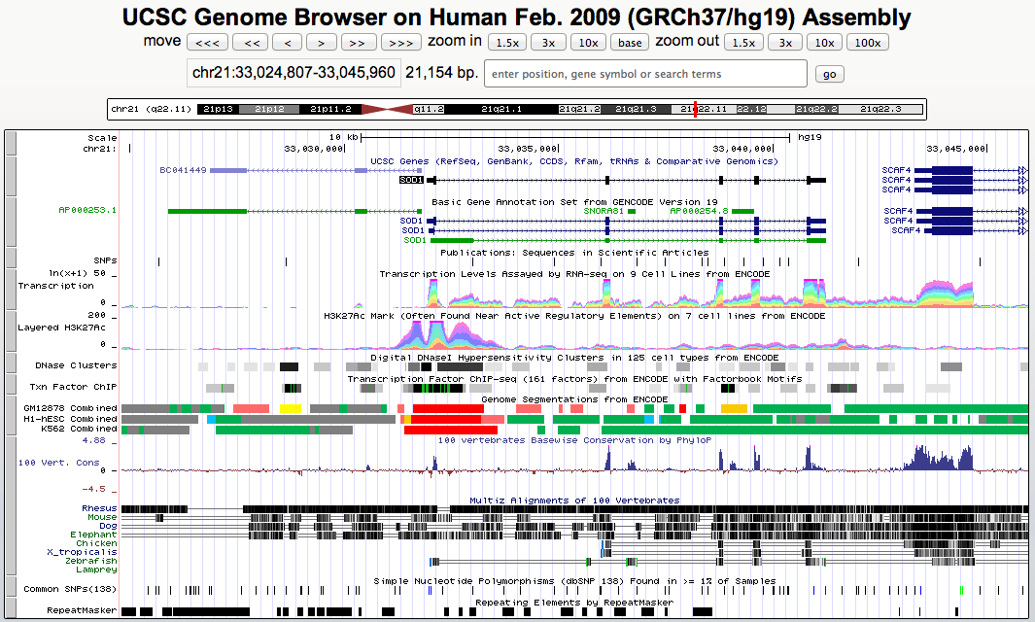


Online genome browsers

Slide 24
Demo - using genome browsers
An overview of Ensembl genome browser

Slide 25
Bibliography and further reading
Collection of Git exercises: https://github.com/eficode-academy/git-katas
Tutorial on git: https://swcarpentry.github.io/git-novice/10-open/index.html
How to foster open science with Git: https://opensource.com/article/19/2/open-science-git
Using Git with RStudio: https://jennybc.github.io/2014-05-12-ubc/ubc-r/session03_git.html

